Slide 1
Business Models

Slide 2
Learning Objectives:
Demonstrate understanding of the Business Model Canvas,
Determine and identify the nine key element of the Business Model.

Slide 3
Business Model Canvass
Business Model was generally used by startup companies or organization that serve as a guiding tool to think of a better solution on how to generate new innovating ideas and apply the strategies in marketing the products or services.
The Business Model Canvass was proposed ny Alexander Osterwalder based on his earlier book: BUSINESS MODEL ONTOLOGY.
- The book outlines nine segments which form the building blocks for the business model in a one-page canvass

Slide 4
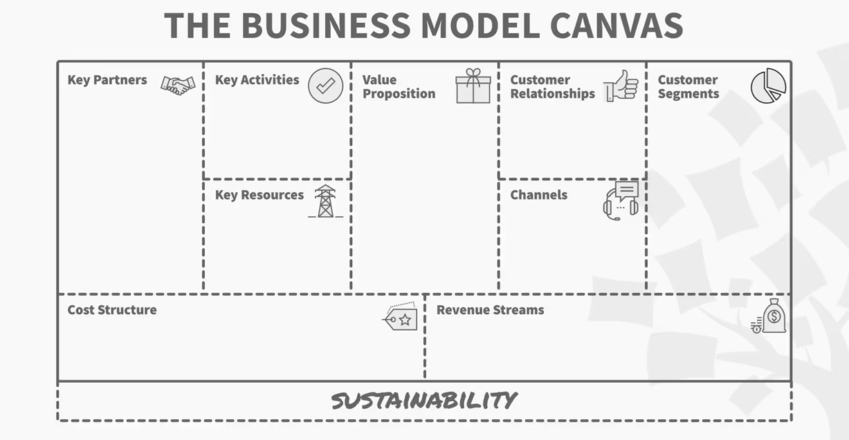

Slide 5
Nine Segments of the Business Model Canvass
Customer Segments:
Who are the customers? What do they think? See? Feel? Do?
a. Segment Dimensions:
Do you have a single or multi-sided market?
b. Segment Composition:
You should be able to personalize individual types as “Personas”
c. Problem, Needs, Habit and Current Alternatives:
What need are you fulfilling for the customer?

Slide 6
Nine Segments of the Business Model Canvass
2. Value Proposition:
What’s compelling about the proposition? Why do customers buy, use?
A value proposition refers to the value a company promises to deliver to customers should they choose to buy their product.
A value proposition is also a declaration of intent or a statement that introduces a company’s brand to consumers by telling them what the company stands for, how it operates, and why it deserves their business(Twin, 2019).

Slide 7
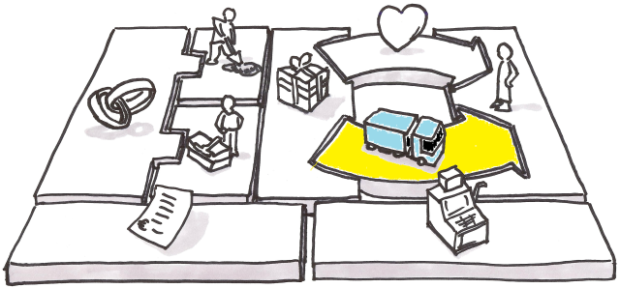
3. Channels
How are the propositions promoted, sold and delivered? Why? Is it working?
The Channel Building Block describes how a company communicates with its customer segments to deliver its value proposition. It is important to understand which pathway is best for your company to reach your customers.

Slide 8
TYPES OF CHANNEL PHASES:
AWARENESS - businesses intend to advertise their product and services through word of mouth, social media, newspaper, television and flyers.
EVALUATION – it is a great plan to conduct first an evaluation so the the company will be able to assess the company’s Value Proposition.
PURCHASE – there are options for customers on how to purchase the product or service.Remember to provide convenience to customers when doing payments.
DELIVERY – one value proposition for customers is the convenience and faster delivery of orders or products or services.
AFTER SALES – How will the company provide post-purchase customer support?

Slide 9
Nine Segments of the Business Model Canvass
4. Customer Relationships:
How do you interact with customer through their ”journey?
A customer relationship is an important aspect if you are doing a business because your customer will be able to interact with you, they can ask questions precisely about the products and services that the company is offering.

Slide 10
Benefits of good customer relationship
Customer Retention - businesses intend to advertise their product and services through word of mouth, social media, newspaper, television and flyers.
Customer Loyalty – highly valuable for businesses as repeat customers are nine time more likely to do business with an organization again if the company handles customer service issue fairly, even if the outcome isn’t in their favor.
Customer Satisfaction – There should be open channel of communication for relaying customer feedback. Positive customer relations give companies more insight into their customer’s problems. This leads to better individual interactions with customers which builds up trust over time and influences their buying decisions.

Slide 11
Nine Segments of the Business Model Canvass
5. Revenue Streams:
How does the business earn revenue from the value propositions?
REVENUE is the amount of money that is brought into a company through if various businesses.
REVENUE STREAM is the building block presenting the cash a company generates from each customer segment. Most businesses need at least one great revenue stream to earn money.

Slide 12
How to generate Revenue Streams
Sale of Physical Product – the customer pays in cash for the product, and the customer is then free to whatever they want with it such as books, furniture and gadgets.
Usage fee– The customer pays a user fee for a particular service, the amount is paid depending on the usage.
Subscription fee – The customer pays, for a particular service in a specifies time frame.
Lending/renting/leasing – grants someone the right to use a product for a fixed period of time in return for a fee.
Brokerage fees- your company get its revenue from an intermediate service. This method is often used by real state agents and credit card providers.
Advertising – your business may charge fees for advertising a product, service or brand.
Volume and unit selling – your company charges a fixed price for a product, but can provide a lower cost depending on the quantities like wholesale.

Slide 13
Nine Segments of the Business Model Canvass
6. Key Activities:
What uniquely strategic things does the business do to deliver its proposition?
Key Activities are the most important tasks a company must carry out to fulfill its business purpose. To be successful, a company must carry out key actions that are primarily dictated by its business model.

Slide 14
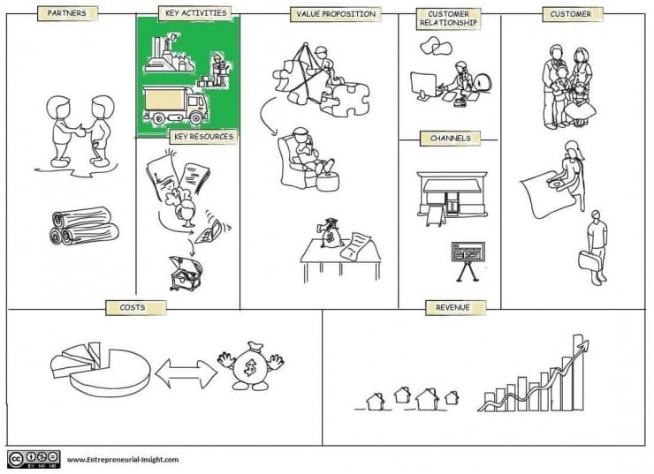

Slide 15
Nine Segments of the Business Model Canvass
6. Key Activities:
What uniquely strategic things does the business do to deliver its proposition?
Key Activities are the most important tasks a company must carry out to fulfill its business purpose. To be successful, a company must carry out key actions that are primarily dictated by its business model.

Slide 16
Nine Segments of the Business Model Canvass
7. Key Resources:
What unique strategic assets must the business have to compete?
Key Resources are the main inputs that your company uses to create its value proposition, service its customer segment and deliver the product to the customer. .

Slide 17
Types of Key Resources
Physical Resources – are what we call tangible resources that most companies or organization uses to create its value propositiions. It includes equipment, inventory, buildings, manufacturing plants and distribution networks that enable the business to function.
Intellectual Resources– They are non-physical, intangible resources like brand, patents, copyrights, and even partnerships. Customer list, customer knowledge and even your own people , represent a form of intellectual resource.
Human Resources –Human resources are specifically the people behind the organization. The employees are the most important assets of an organization. Great ideas are from human beings and companies require a great deal of creativity and extensive knowledge from them.
Financial Resources –includes cash, lines of credit and the ability to have stock option plans for employees. All businesses have key resources in finance, but some will have stronger financial resources than others, such as banks that are based entirely on the availability of this key resource.

Slide 18
Nine Segments of the Business Model Canvass
8. Key partnerships:
What can the company not do so it can focus on its Key Activities?
Key Key partners are the relationships that you have with other business, governmental, or non-consumer entities that help your business model work. These can be relationships that your company has with your suppliers, your manufacturers, business partners, etc.

Slide 19
Types of Partnerships
Strategic alliances between non-competitors –.This provide an idea where two companies will develop harmonious relationship.
Coopetition–combination of “competition” and “cooperation” into one idea. It may seem that these two concepts diametrically opposed, but in fact, competitors can often benefit from cooperating with one another strategically(Poarch,2018).
Joint venture to develop new businesses - company may join another company to create a different entity which maybe more profitable for both of you if you were to operate separately.
Buyer-supplier relationship – in every business, the buyer and supplier should incorporate the characteristics of trust, quality, and commitment between them to maintain an amicable relationship to achieve success.

Slide 20
Nine Segments of the Business Model Canvass
9. Cost Structure:
What is the business’ major cost drivers? How are they linked to revenue?
Cost Structure defines all the costs and expenses that your company will incur while operating your business. This final step in the process is important, because it will help your team decide whether to pivot or proceed.

Slide 21
Categories of Cost Structure
Value-Driven –The focus of value-driven cost structure is to create more value in the product itself.
Cost-Driven – focus on minimizing the costs of the product or service as much as possible..

Slide 22
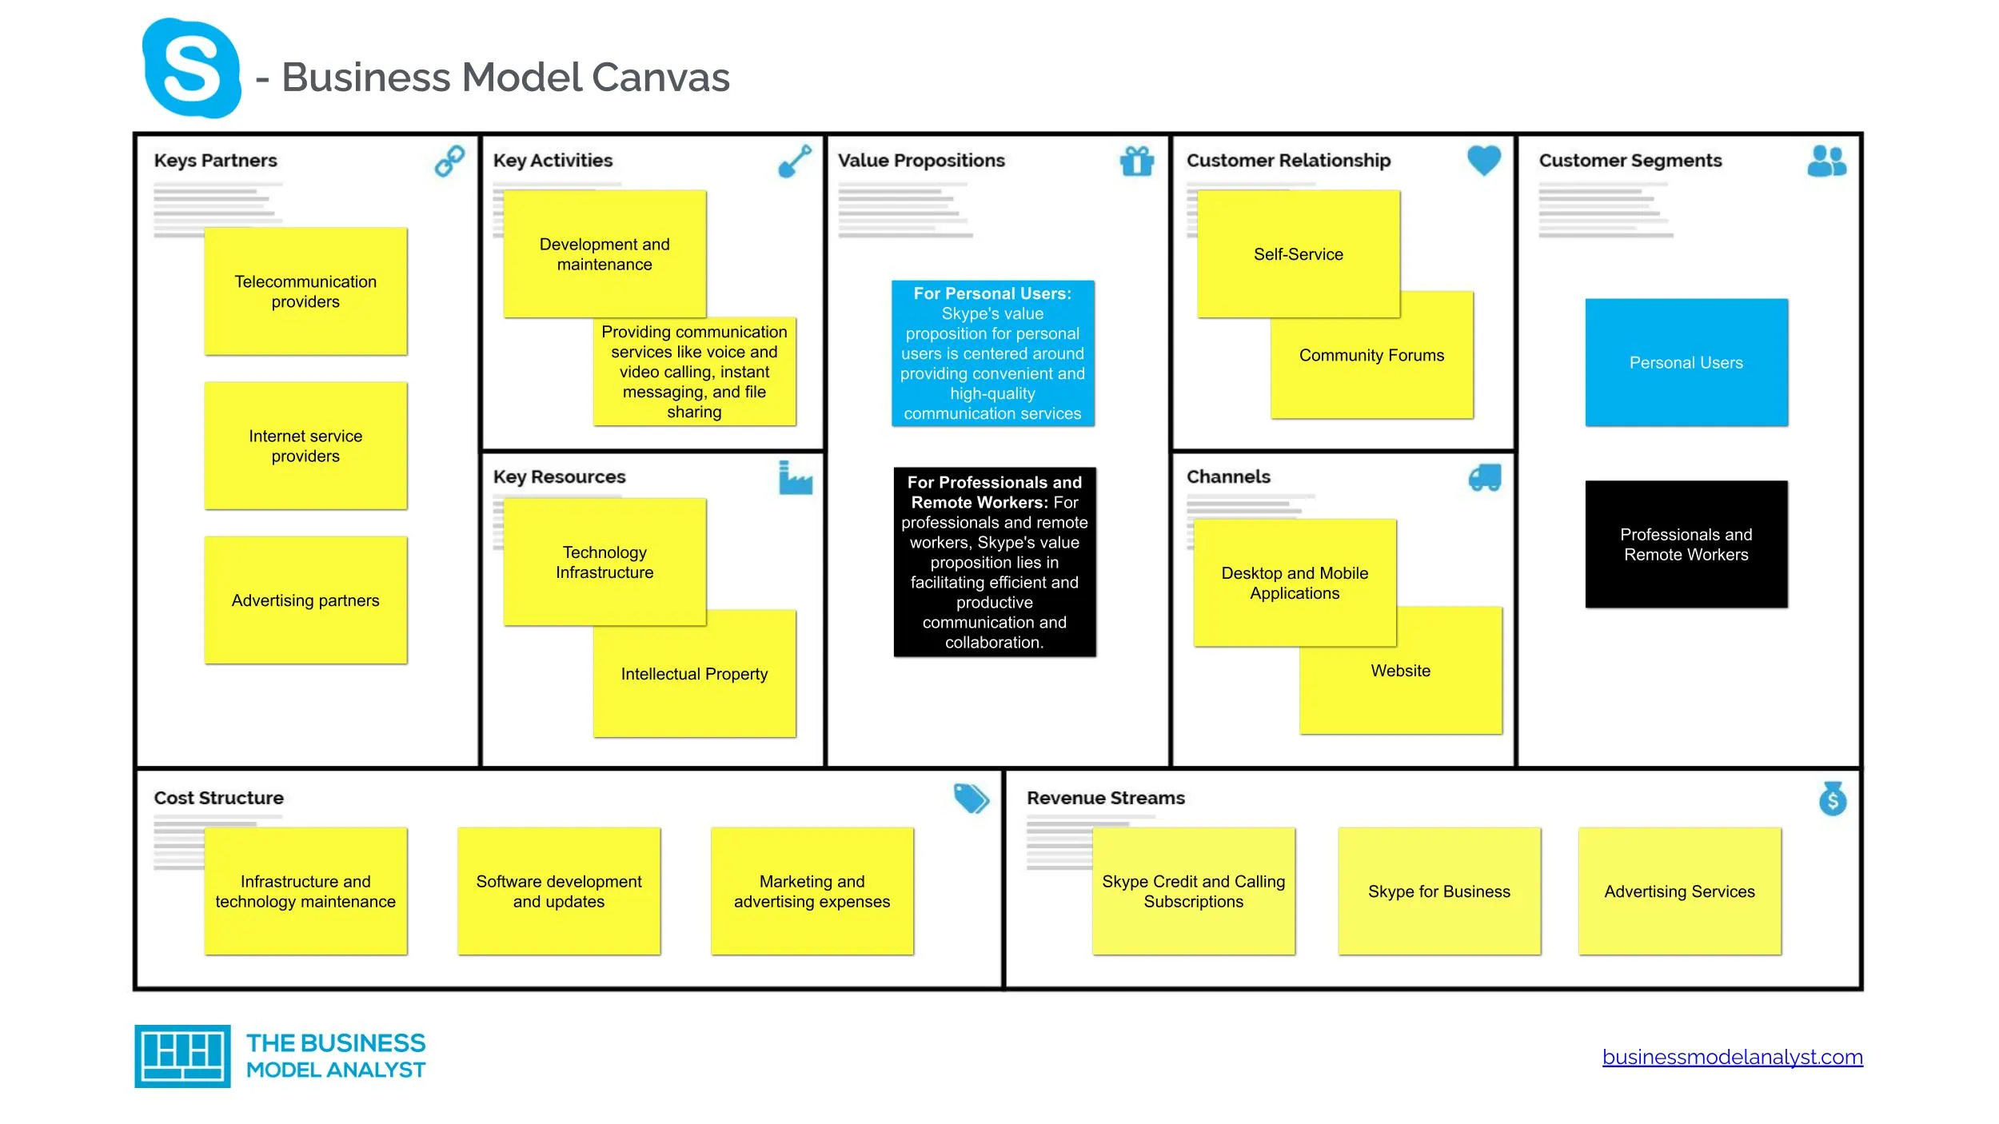
Business model canvas of SKYPE

Slide 23
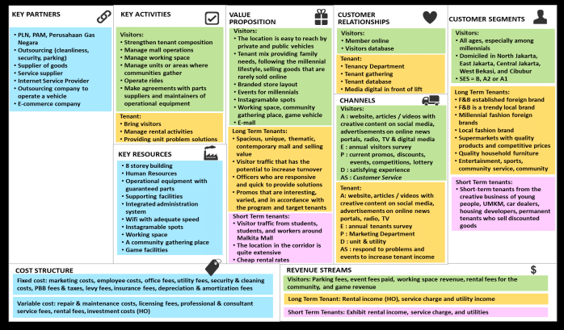

Slide 24
Thank you

